Slide 1
The Monte Carlo Experiment
The Effect of the number of tested numbers in a Monte Carlo Simulation on a Numeral Outcome close to the value of π
Ike Kaper, Alan Zhang, Derek Kimball, Daniel Zhou

Slide 2
Our Research Question:
How is the percent difference associated with run length, if at all?

Slide 3
What is a Monte Carlo Simulation?
A Monte Carlo Simulation is a mathematical technique that generates random variables for modelling risk or uncertainty of a certain system.

Slide 4
What did we use the simulation for?
Our group calculated experimental values for π using a Python program and analyzed the data within Microsoft Excel/Google Sheets.

Slide 5
Our Goals:
Determine the association, if at all, between the accuracy of a simulation and the length (how many points used to calculate π) of the simulation
Determine the association, if at all, between the spread of resulting values of π and how many coordinates/points were used in the simulation
Determine the association, if at all, between the length of the simulation and the execution time.

Slide 6
Our Procedure
We construct a Monte Carlo simulation to determine a value for π by having the program generate 2 sets of random numbers (for the x and y dimensions) between 0 and 1. If, as the image above states, the sum of the 2 squares is less than 1, the point is counted as falling inside the area of the quarter circle.
At the end, the experimental value of π is calculated by dividing the number of points inside the quarter circle by the total amount of points "thrown".
Multiply the ratio from above by 4, since otherwise, as the equation from above demonstrates, the result would be approaching π/4

Slide 7
Visual of how the Simulation is run

Slide 8
Summary Statistics of Approximate Calculated Values of pi
Number of Points Tested | 10 | 50 | 100 | 500 | 1,000 | 5,000 | 10,000 | 50,000 | 100,000
Average Mean | 3.04 | 3.096 | 3.076 | 3.1096 | 3.1368 | 3.15144 | 3.145052 | 3.1418 | 3.14052
Average Median | 3.2 | 3.12 | 3.02 | 3.108 | 3.126 | 3.1452 | 3.14638 | 3.1412 | 3.1452
Standard Deviation | 0.57193 | 0.25868 | 0.17734 | 0.07155 | 0.04481 | 0.02104 | 0.00546 | 0.0075 | 0.02396
Notes:
We truncated some of the values to make it fit better

Slide 9
Summary Statistics of Percent Error from Pi
Number of Points Tested | 10 | 50 | 100 | 500 | 1,000 | 5,000 | 10,000 | 50,000 | 100,000
Average Mean | -3.2338 | -1.4513 | -2.0879 | -1.0184 | -0.15256 | 0.31345 | 0.00345 | 0.00021 | -0.00107
Average Median | 1.8592 | -0.68732 | -3.8704 | -1.0692 | -0.49633 | 0.11482 | 0.00479 | -0.00039 | 0.00361
Standard Deviation | 18.205 | 8.2341 | 5.6449 | 2.2778 | 1.4264 | 0.66988 | 0.00546 | 0.00756 | 0.02396
Notes:
We truncated some of the values to make it fit better

Slide 10
Summary Statistics of Execution Time
Number of Points Tested | 10 | 50 | 100 | 500 | 1,000 | 5,000 | 10,000 | 50,000 | 100,000
Mean | 0.002496 | 0.00163 | 0.00414 | 0.01161 | 0.02405 | 0.15282 | 0.38346 | 6.3749 | 161.0620
Average Median | 0.002073 | 0.00149 | 0.00397 | 0.01141 | 0.02430 | 0.15053 | 0.38191 | 6.9445 | 161.178
Standard Deviation | 0.00080 | 0.00024 | 0.00025 | 0.00035 | 0.00074 | 0.00673 | 0.00627 | 2.1913 | 4.1080
Notes:
We truncated some of the values to make it fit better

Slide 11

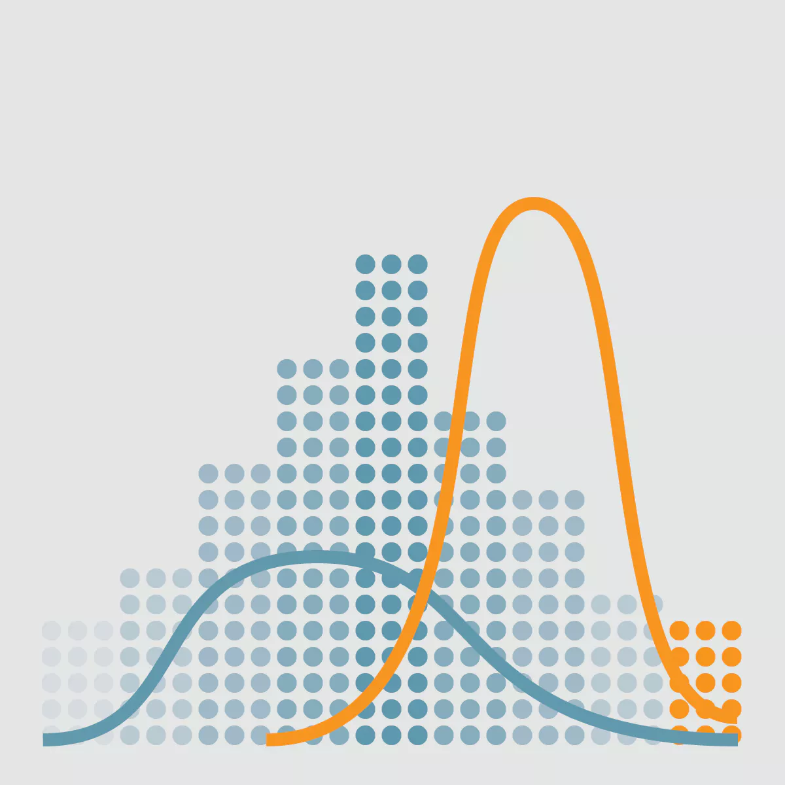
Representation of Our Data

Slide 12

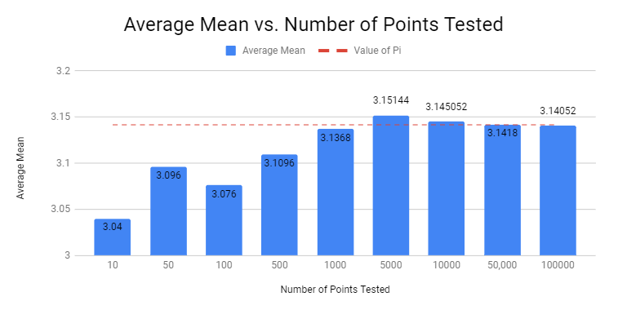
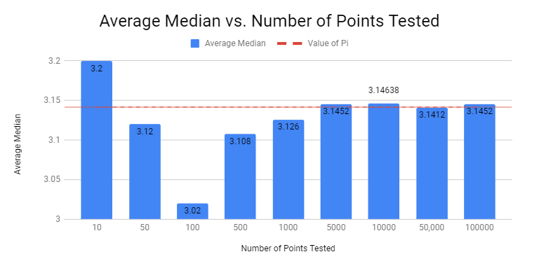
Average Mean and Median vs Number of Points Tested

Slide 13
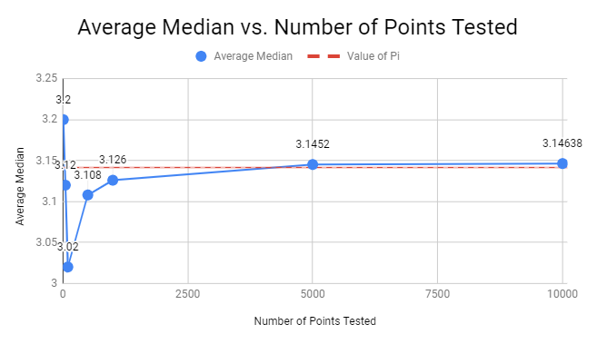
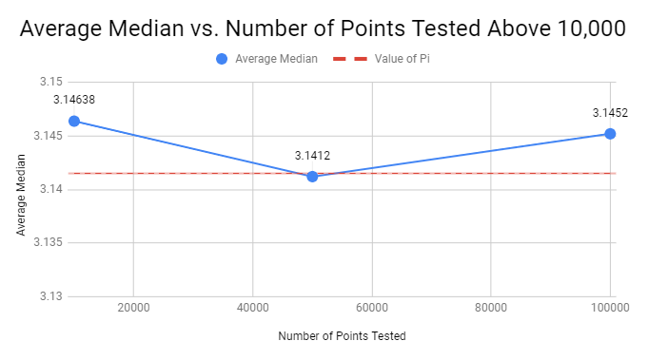
Progression of Average Median as Tested Numbers Increased on Line Graphs

Slide 14
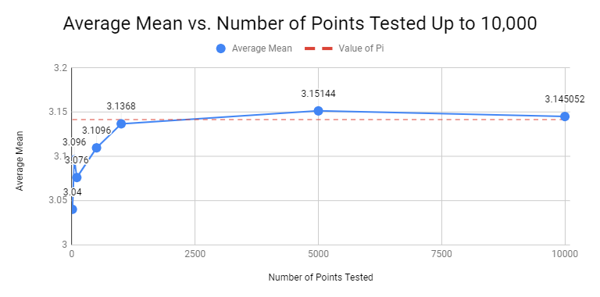
Line Graph of the Average Mean as Tested Numbers Increased

Slide 15
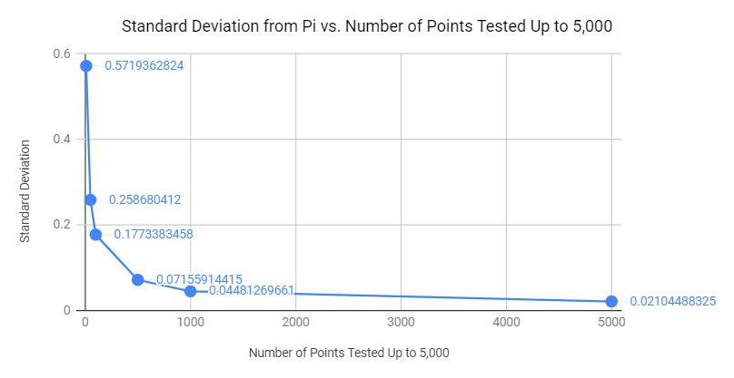
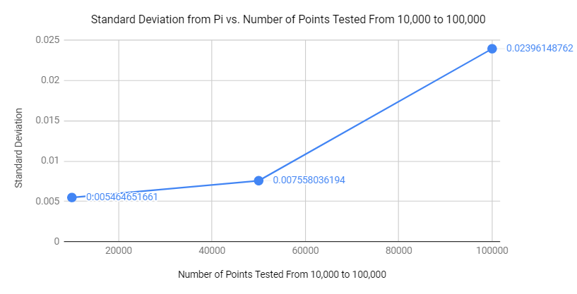
Standard Deviation from pi

Slide 16

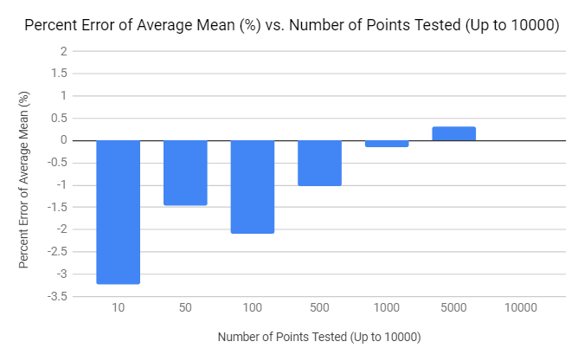
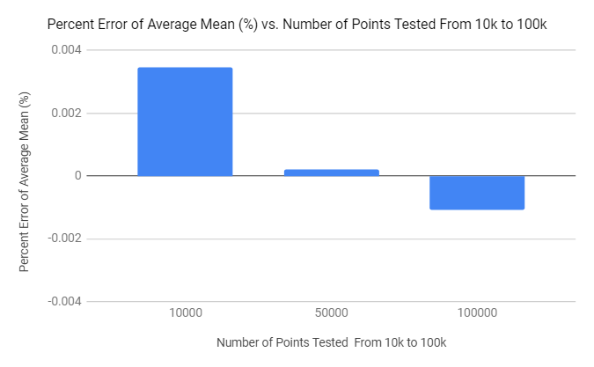
Percent Error of Average Mean

Slide 17
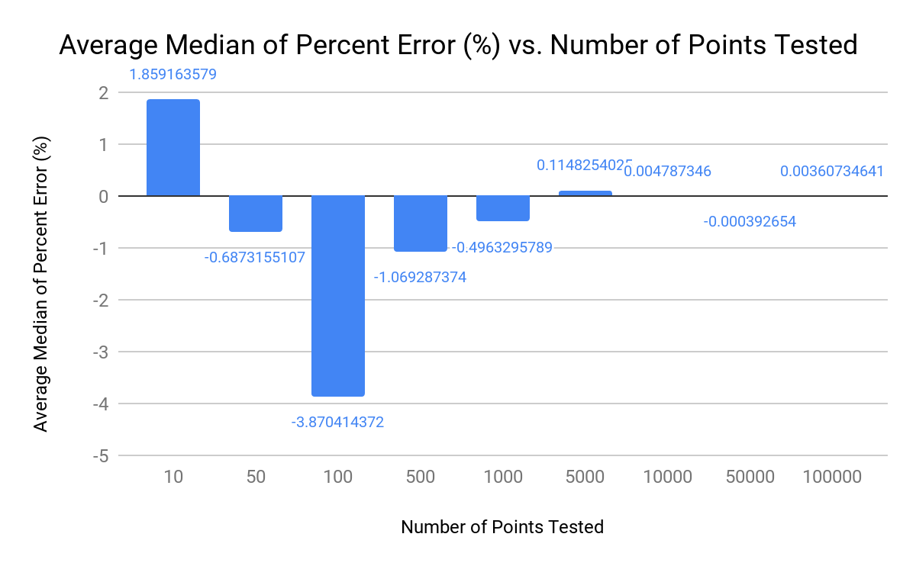
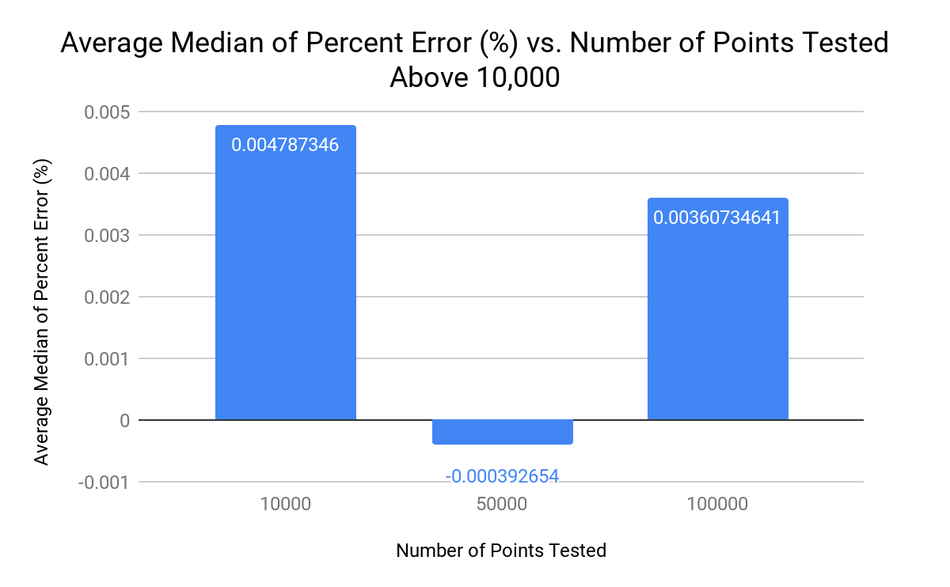
Percent Error of Average Median

Slide 18
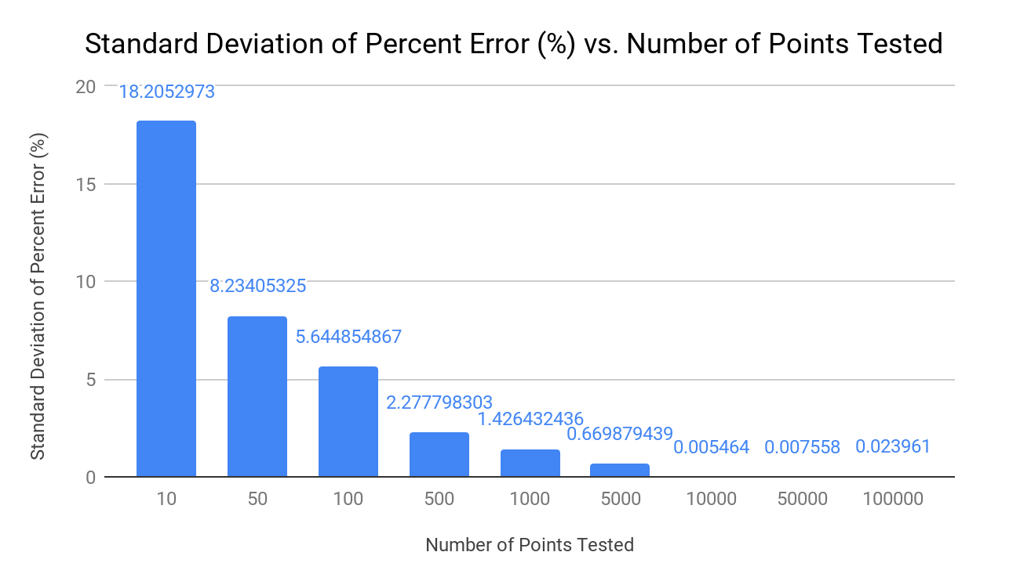
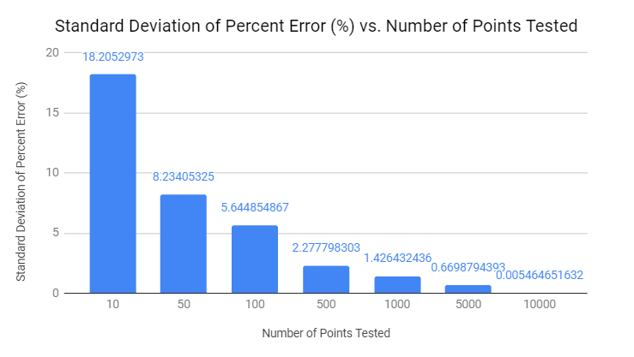
Standard Deviation of Percent Error

Slide 19
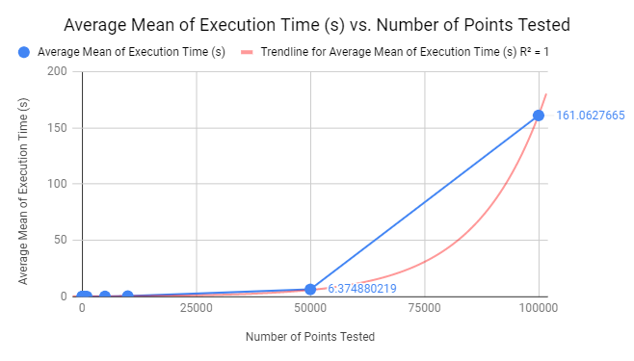
The Progression of the Average Median Execution Time as the Number of Points Increased
Exponential equation:
Average Mean = 0.215e^6.62E - 0.5x

Slide 20
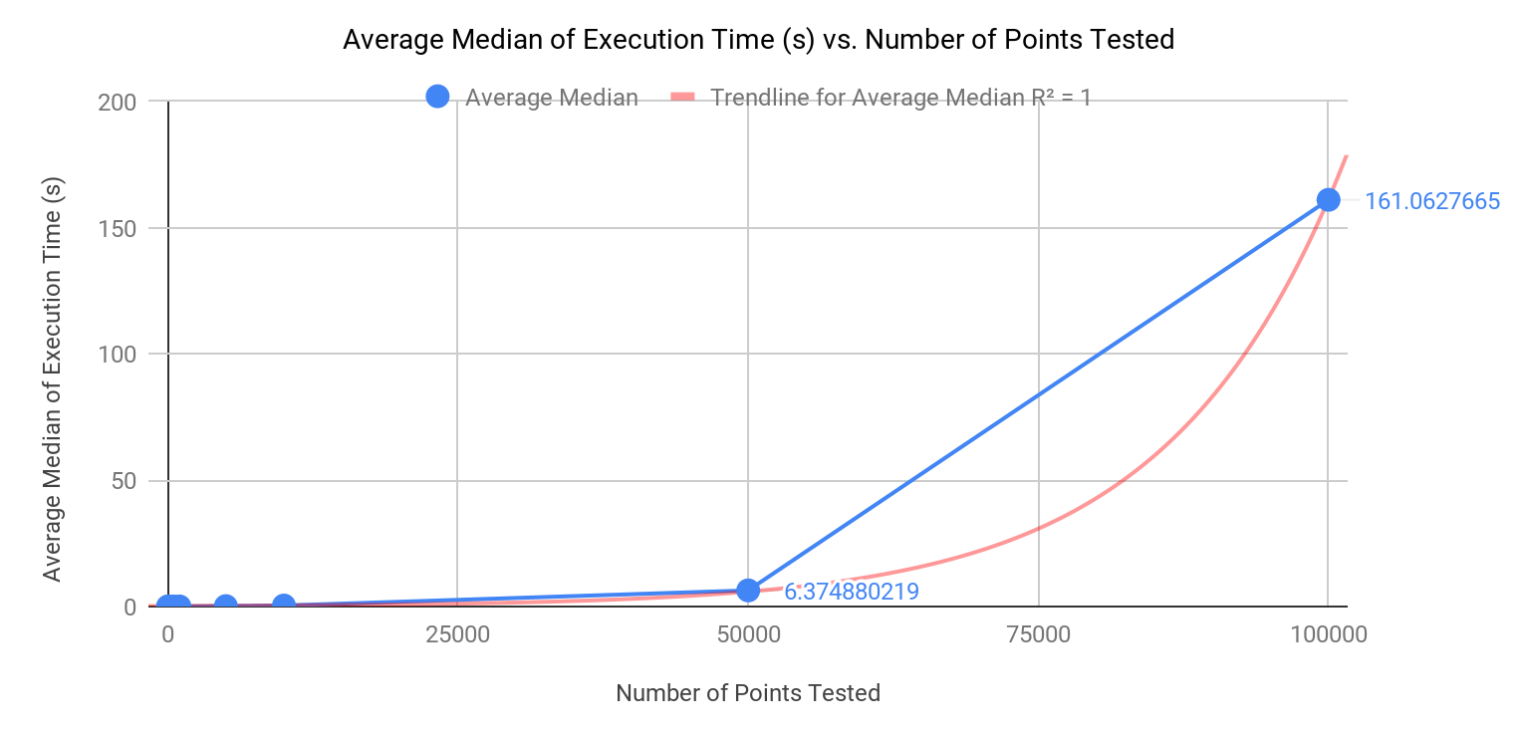
The Progression focused on Numbers Tested below 10,000

Slide 21
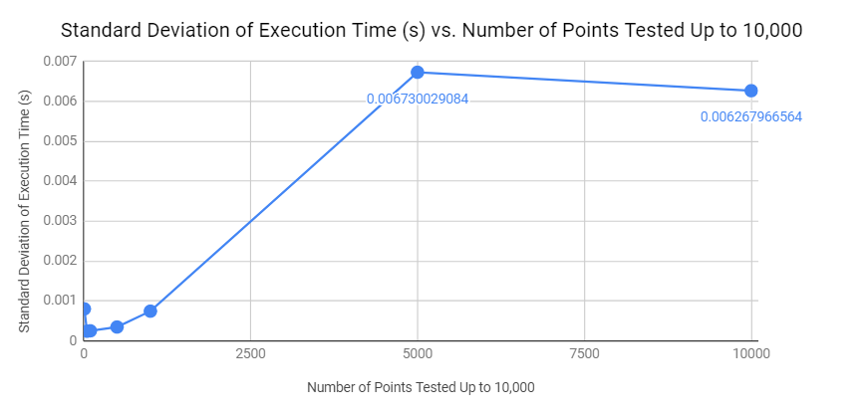
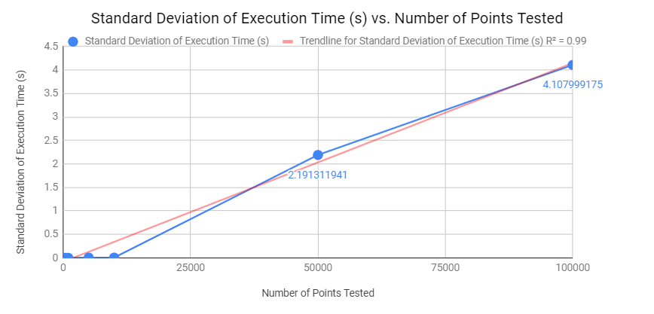
Visual representation of our Data

Slide 22
Analysis of the Data: What did we find?
As more numbers were tested, the averages plateaued towards pi, even though the average median did have some bumps.
From the tested numbers higher than 10,000, the percent error of the average median from pi decreased towards zero
The percent error of the average median from pi also approached zero

Slide 23
Analysis of the Data: What did we find?
In both data, 50,000 tested numbers was the closest to zero percent error (0.000207346041% off for the average mean) from pi.
As more numbers were tested, the execution time increased exponentially, and a one to one equation could be formulated to predict results.

Slide 24
Conclusion
How is the percent difference associated with run length, if at all?

Slide 25
As we increased our run length from the tested numbers higher than 10,000 on the bar graph of the percent error of the average mean from pi, the percent error decreased towards zero, and closer to the Value of π. From the run length of 10,000 and on, there was not a statistical significant change in percent error from π.

Slide 26
As the run length increased, the spread of the resulting values decreased because the sample size was so big it ignored the outliers. The time it took to run the python program increased exponentially. There is a hidden outlier which is the code itself.

Slide 27
Live Demo
Questions?

Slide 28
Problems

Slide 29
Github Link
https://github.com/IkeKap/StatsProject

